Slide 1
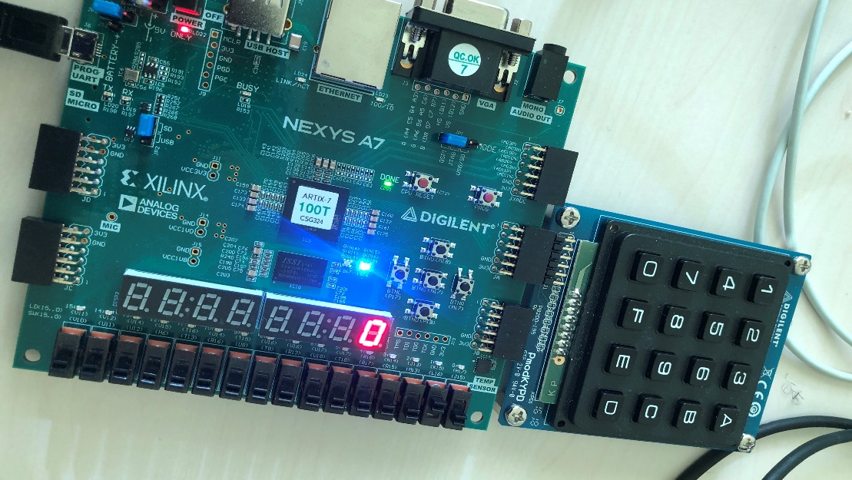
Password Alarm System
Kuye Doluwamu
Ajay Paul
Ashraf Siddiqi Mohammad

Slide 2
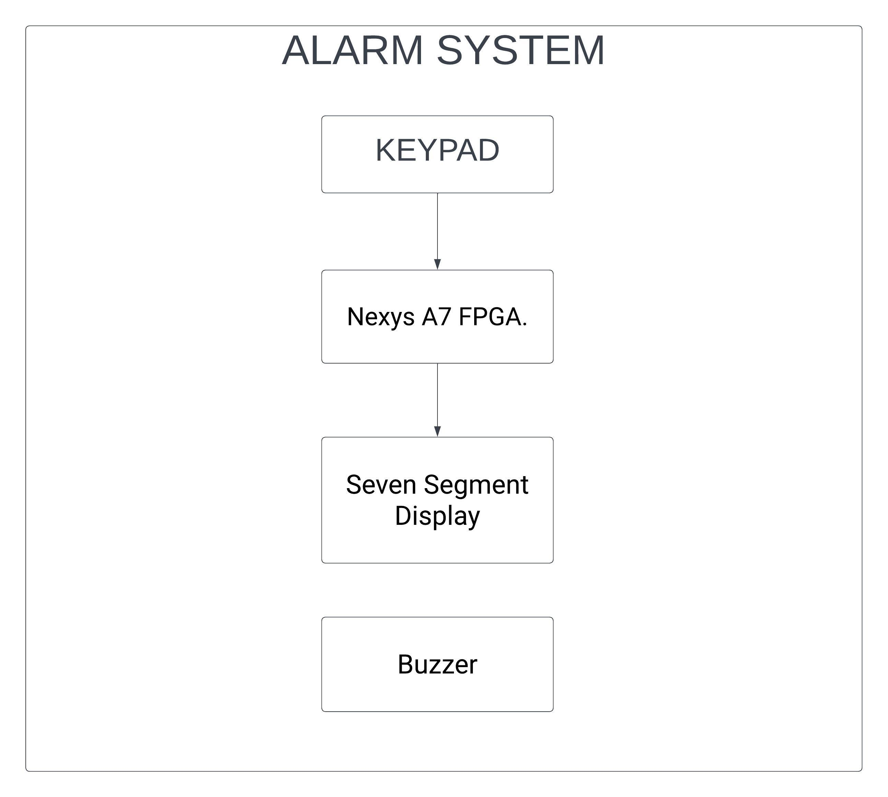
Block Diagram Of the System

Slide 3
Test Bench
Test bench is to clarify and check the codes, whether it's ok or not and to specify the inputs that we declare to make sure the output in the process of time.

Slide 4
Iterative Process
1 key comparator
4 key comparator with 1 comp module
2 key comparator
4 key comparator with 4 comparator modules and 1 final comparator module

Slide 5
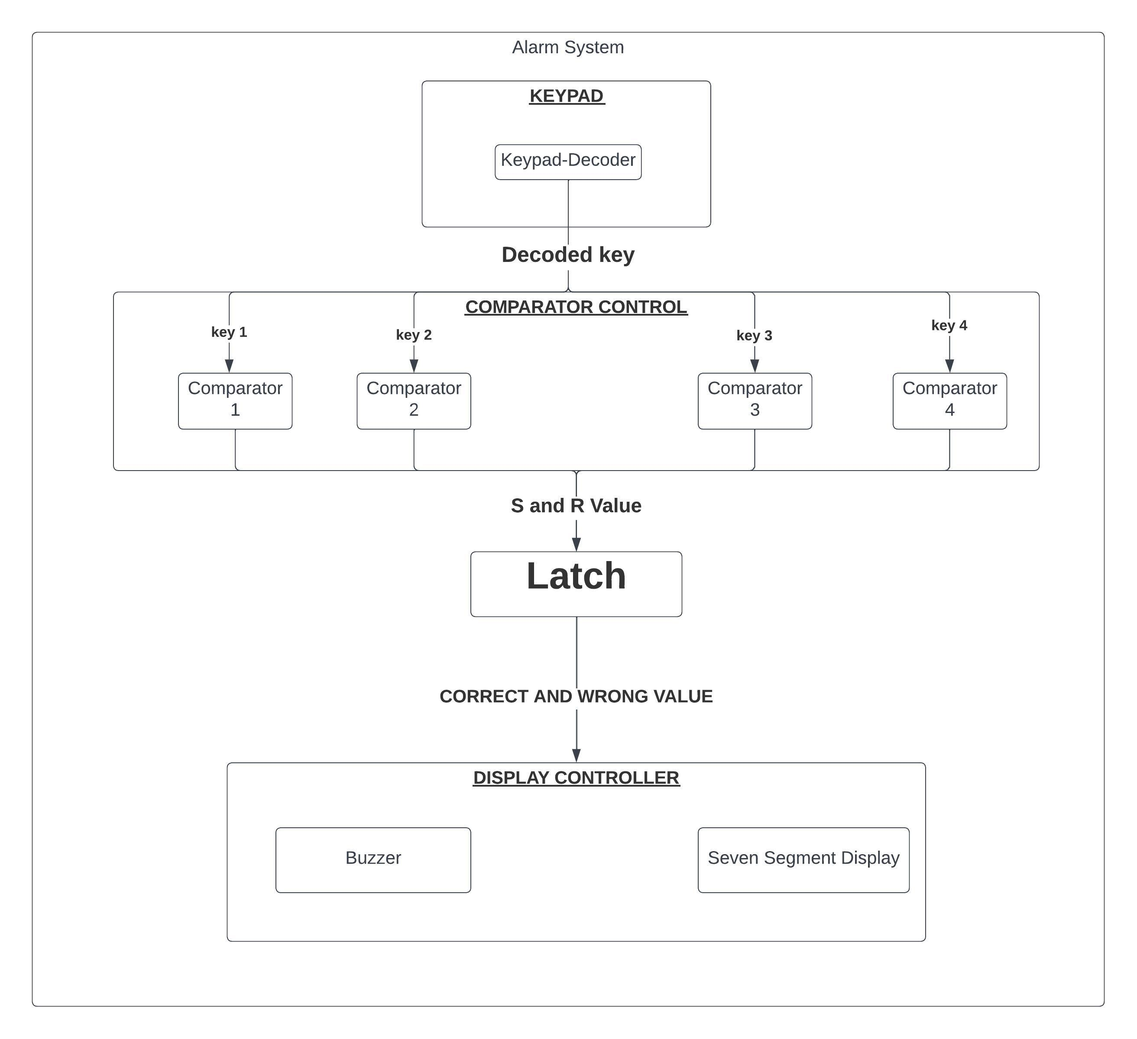
All System Modules

Slide 6
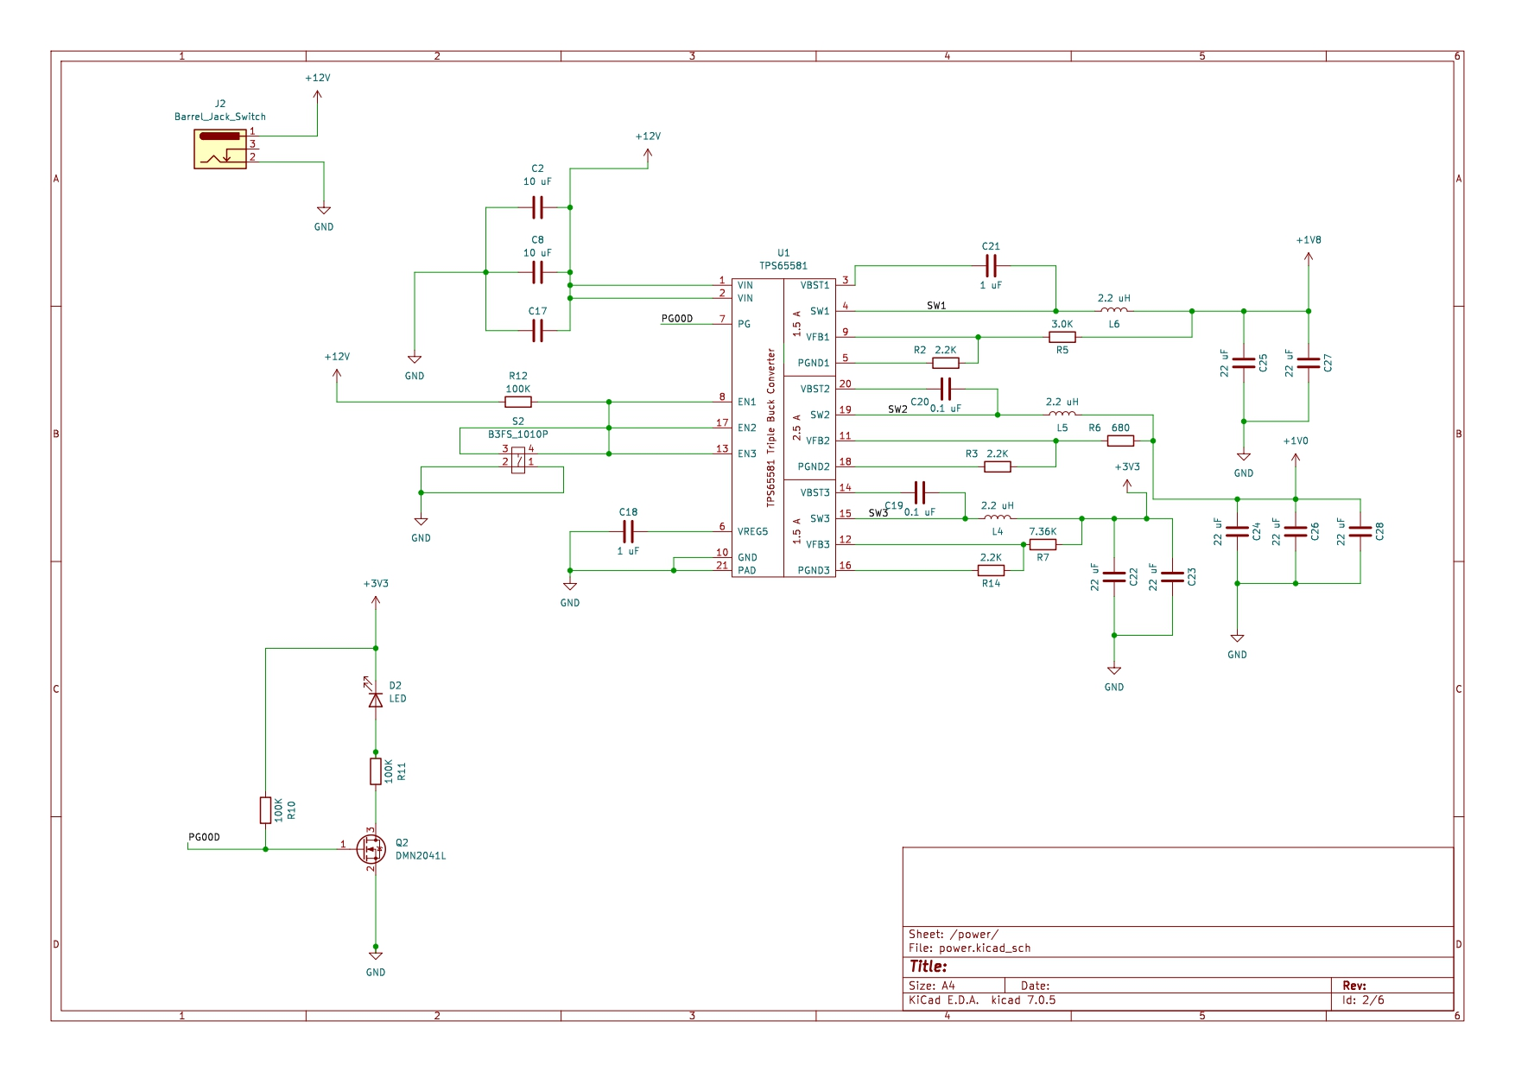
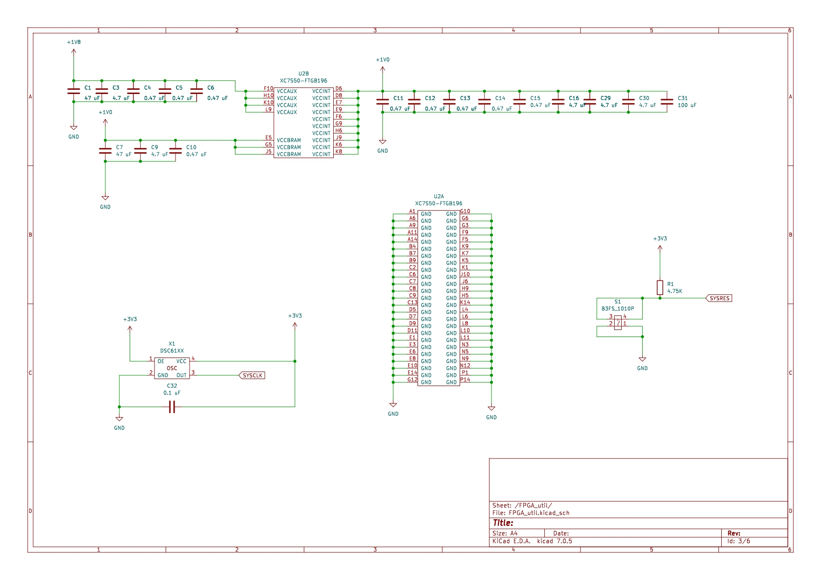
PCB Schematics

Slide 7
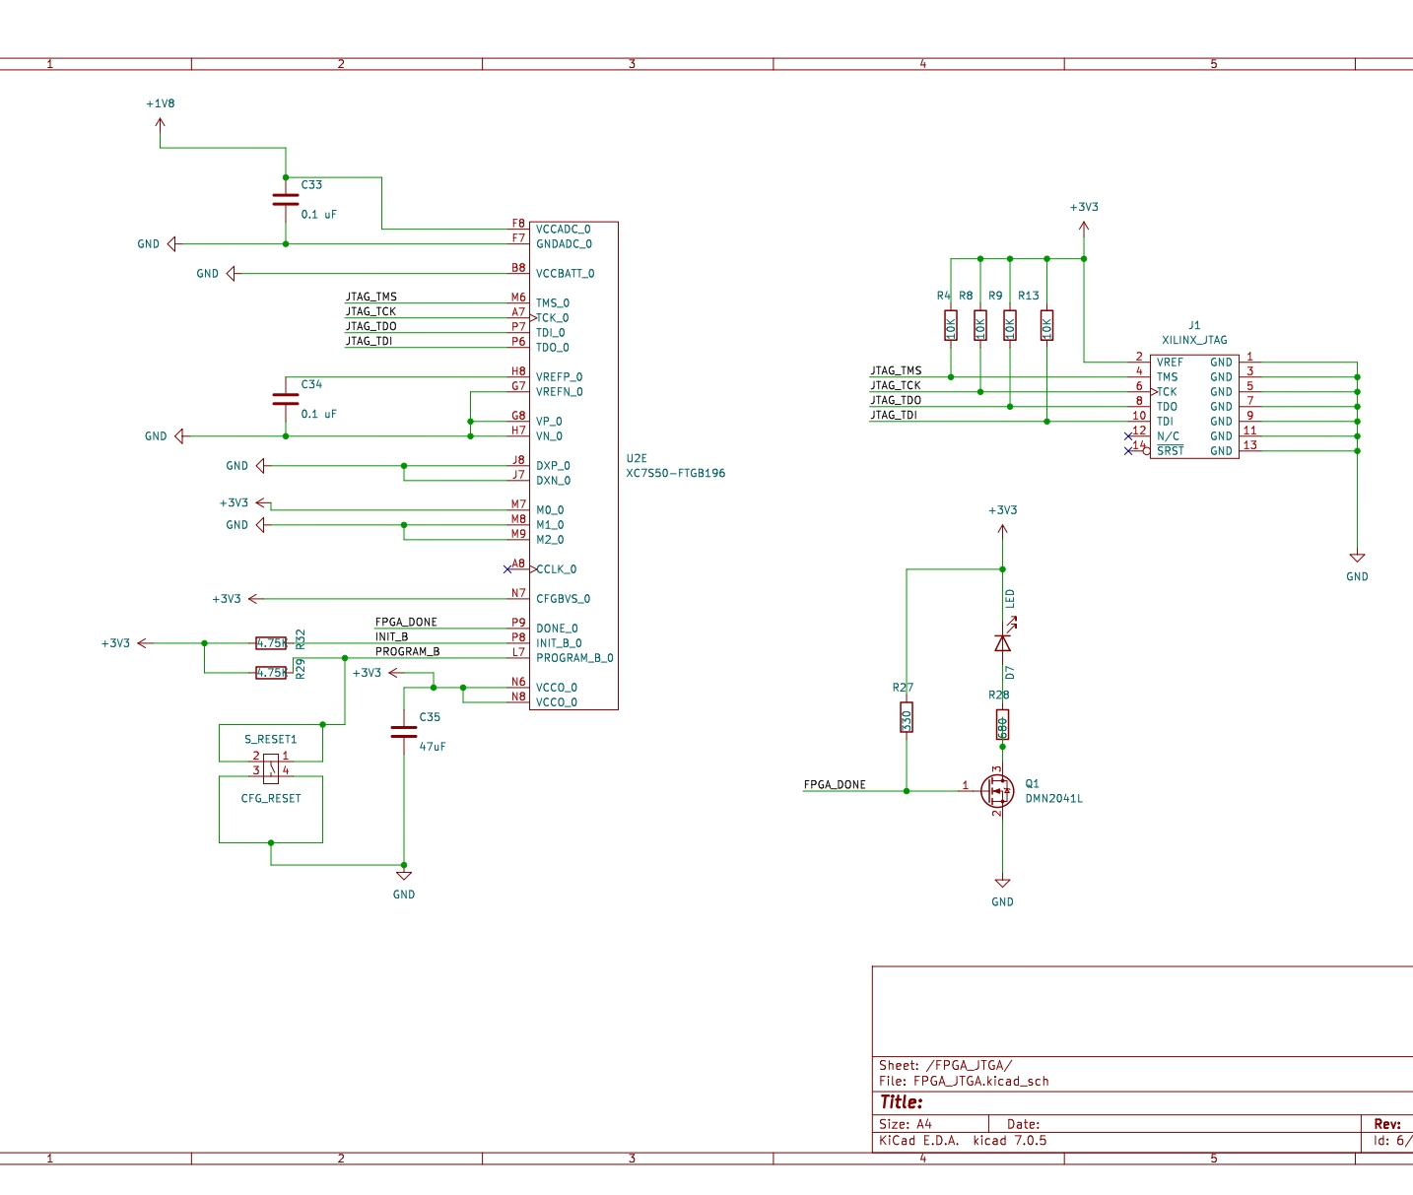
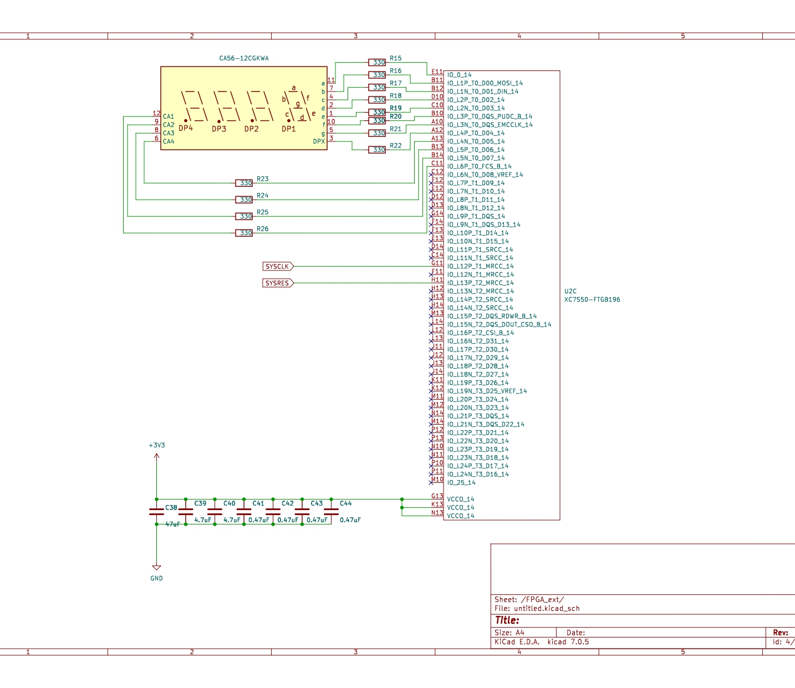
PCB Schematics

Slide 8
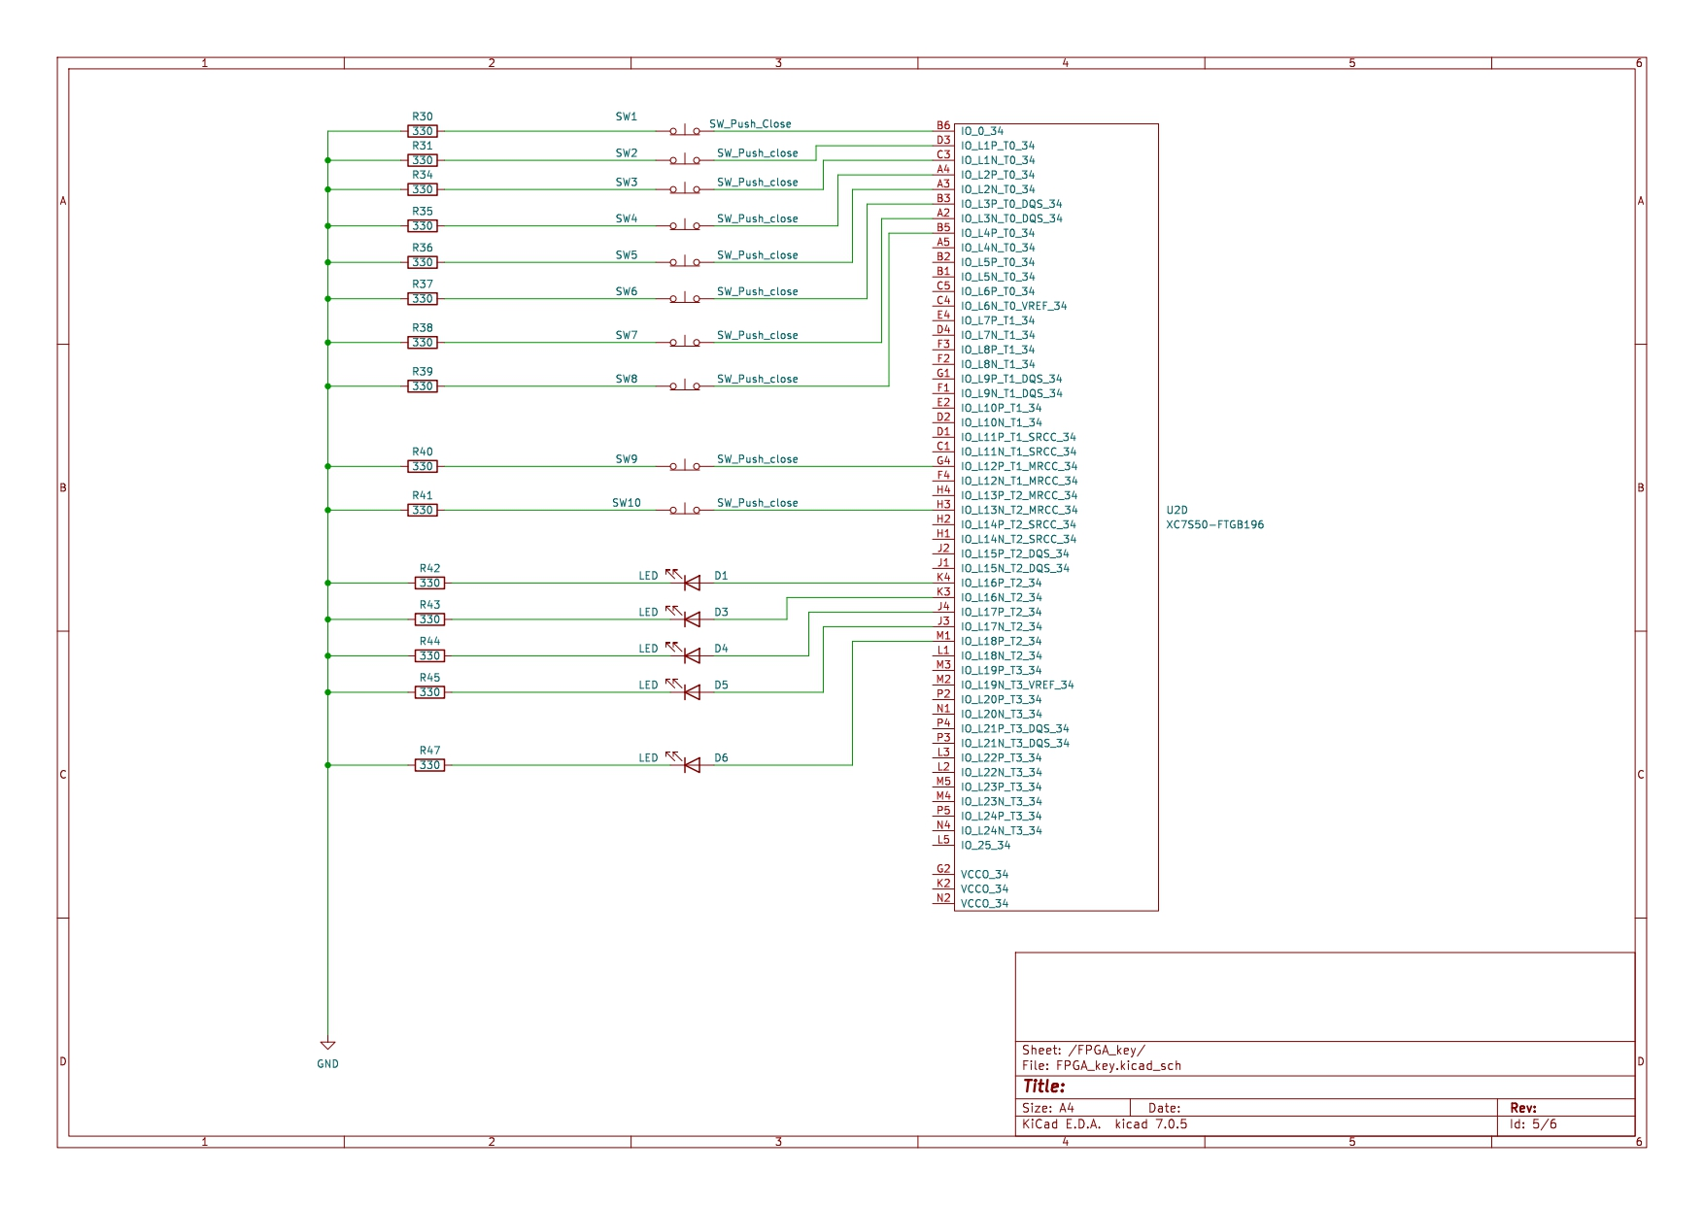
PCB Schematics

Slide 9
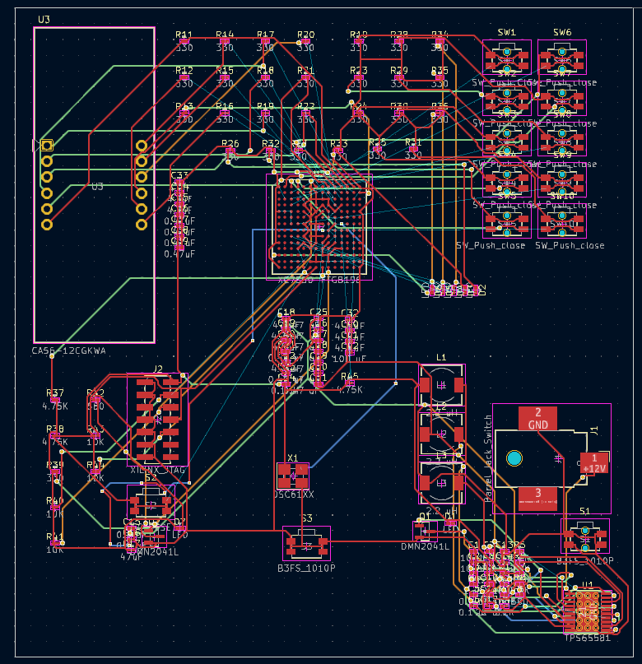
PCB Routing

Slide 10
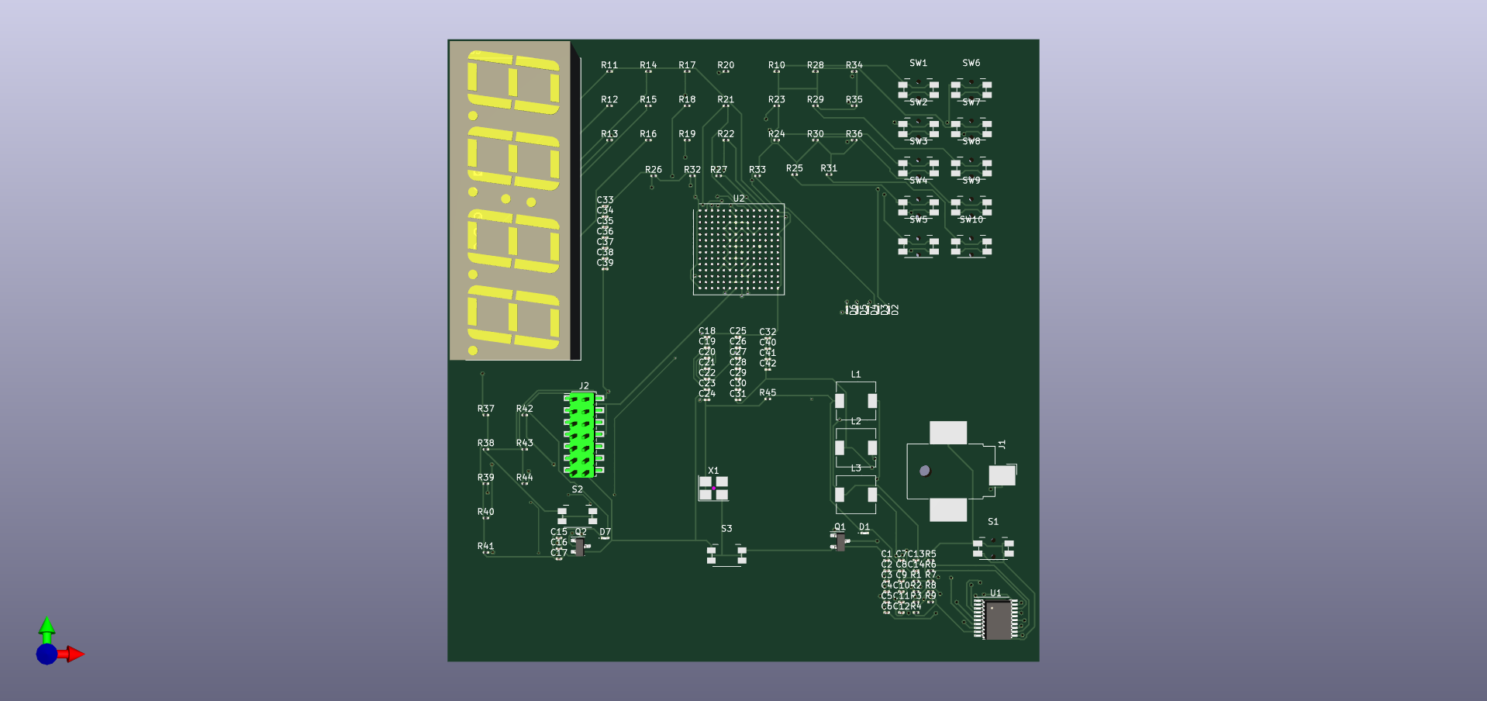
PCB 3D Model

